Slide 1

Contributing to Helm

Slide 2
Guess the number of PRs I have raise for helm repository?
My Pull Requests

Slide 3
Totally 6 PRs
3 Merged
3 Unmerged

Slide 4
Guess the number of issues I have been involved in helm repository?
Issues I got involved in

Slide 5
Totally 60 Issues.
33 Closed. I helped close some of them.
27 Open. I’m trying to help.

Slide 6
Some of the ways I contributed in

Slide 7
Reproduce Bugs
and Confirm them

Slide 8
Try to find the root cause of the issue - is it an issue with helm?

Slide 9
When helm is the issue - Find code that’s causing the issue. Try to discuss the solutions.

Slide 10
Help someone else to contribute, by analysing issue, reviewing PR code / trying out PR code

Slide 11
Learnings

Slide 12
No tool is perfect.
Helm has so many bugs.
People create issues / comment on existing ones almost every single day!

Slide 13
Trying to close every other issue is so tough!
It’s like working on production support and getting tickets every hour!

Slide 14
Doing it all alone might sound cool, but it requires so much time and effort. Get help from community members who are willing to raise PRs!

Slide 15
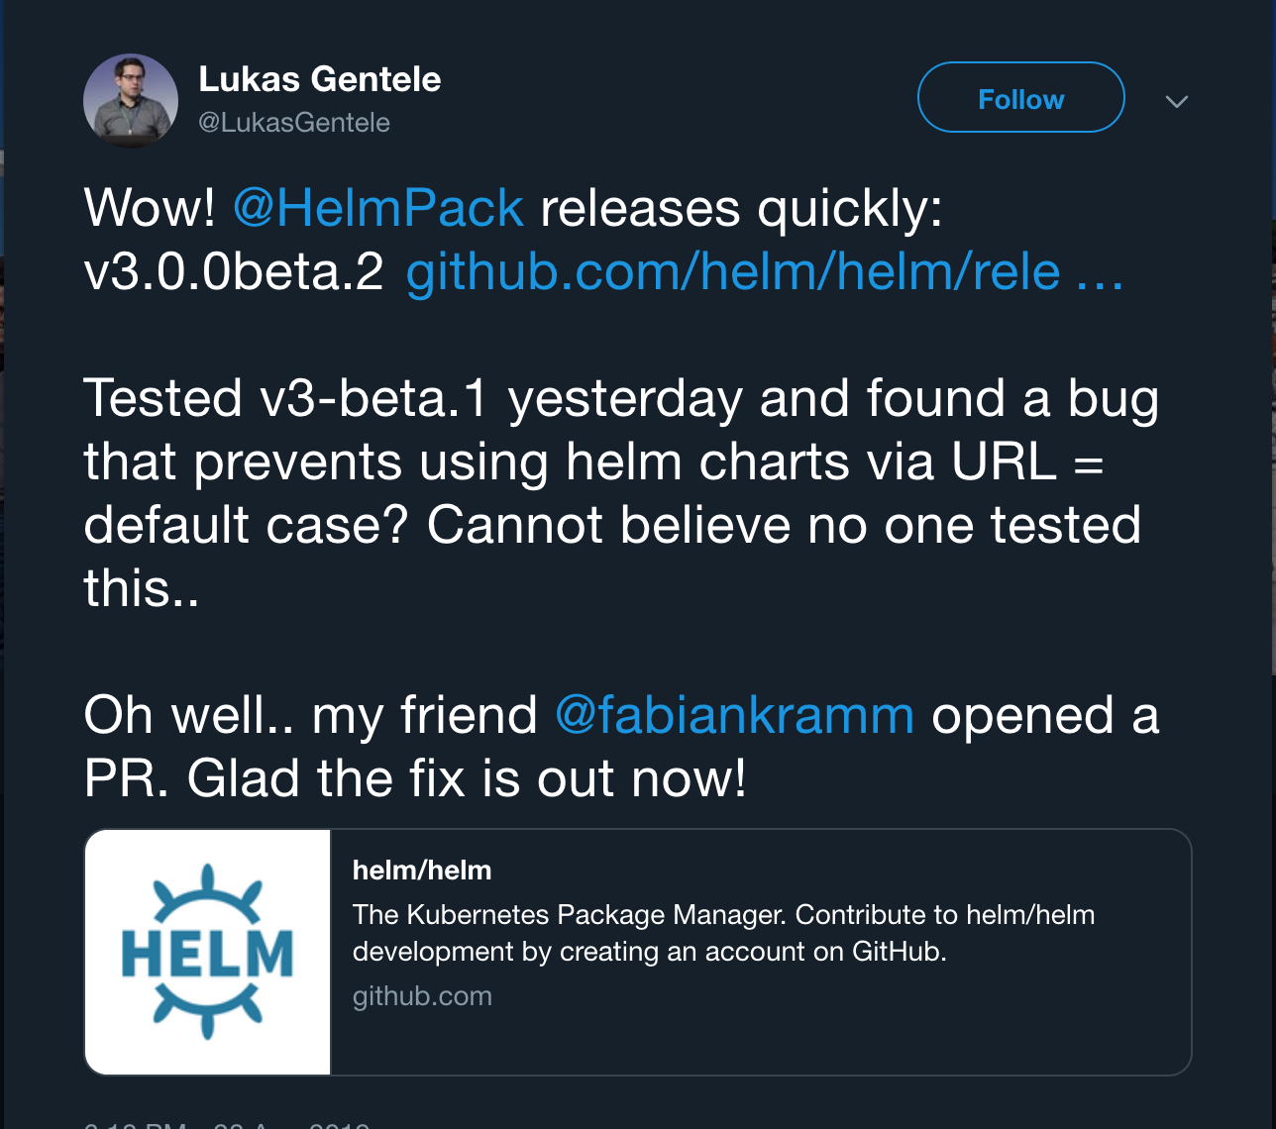

Slide 16
Helm is in so much need of contributors.
Helm v3 has tons of bugs. Lots of them go unnoticed because of lack of some tests.

Slide 17
Starting from bugs in simplest of features like helm list showing multiple revisions of the same release

Slide 18
To very weird issues like helm lint working in Linux, MacOS but not working in Windows. Yes. This happened and I confirmed it

Slide 19
Some things that I have tried to do while contributing is - try to comment on PRs if they don’t have failing tests based on the mentioned issue that it fixes

Slide 20
Bottom line:
Open Source can survive only if it gets contributions in some way or the other. Or people are not going to trust them anymore.

Slide 21

Helm Needs You.
Open Source Needs You.

Slide 22
Thank You!

